Slide 1
Unit 1(Cont)

Slide 2
Conventional Software Management Performance
Barry Boehm's "Industrial Software Metrics Top 10 List” is a good, objective characterization of the state of software development.
Finding and fixing a software problem after delivery costs 100 times more than finding and fixing the problem in early design phases.
You can compress software development schedules 25% of nominal, but no more.
For every $1 you spend on development, you will spend $2 on maintenance.
Software development and maintenance costs are primarily a function of the number of source lines of code.
Variations among people account for the biggest differences in software productivity.

Slide 3
Conventional Software Management Performance Barry Boehm's "Industrial Software Metrics Top 10 List” is a good, objective characterization of the state of software development.
6. The overall ratio of software to hardware costs is still growing. In 1955 it was 15:85; in 1985, 85:15.
7. Only about 15% of software development effort is devoted to programming.
8. Software systems and products typically cost 3 times as much per SLOC as individual software programs. Software-system products (i.e., system of systems) cost 9 times as much.
9. Walkthroughs catch 60% of the errors
10. 80% of the contribution comes from 20% of the contributors.

Slide 4
Software Economics
Most software cost models can be abstracted into a function of five basic parameters: size, process, personnel, environment, and required quality.
The size of the end product (in human-generated components), which is typically quantified in terms of the number of source instructions or the number of function points required to develop the required functionality
The process used to produce the end product, in particular the ability of the process to avoid non value-adding activities (rework, bureaucratic delays, communications overhead)

Slide 5
Software Economics
The capabilities of software engineering personnel, and particularly their experience with the computer science issues and the applications domain issues of the project
The environment, which is made up of the tools and techniques available to support efficient software development and to automate the process
The required quality of the product, including its features, performance, reliability, and adaptability

Slide 6
Software Economics
The relationships among these parameters and the estimated cost can be written as follows:
Effort = (Personnel) (Environment) (Quality) ( Size process)
One important aspect of software economics (as represented within today's software cost models) is that the relationship between effort and size exhibits a diseconomy of scale.
The diseconomy of scale of software development is a result of the process exponent being greater than 1.0. Contrary to most manufacturing processes, the more software you build, the more expensive it is per unit item

Slide 7
Software Economics
The three generations of software development are defined as follows:
1) Conventional: 1960s and 1970s, craftsmanship. Organizations used custom tools, custom processes, and virtually all custom components built in primitive languages. Project performance was highly predictable in that cost, schedule, and quality objectives were almost always underachieved.
2) Transition: 1980s and 1990s, software engineering. Organizattions used more-repeatable processes and off the-shelf tools, and mostly (>70%) custom components built in higher level languages. Some of the components (<30%) were available as commercial products, including the operating system, database management system, networking, and graphical user interface.
3) Modern practices: 2000 and later, software production. This book's philosophy is rooted in the use of managed and measured processes, integrated automation environments, and mostly (70%) off-the-shelf components. Perhaps as few as 30% of the components need to be custom built .

Slide 8
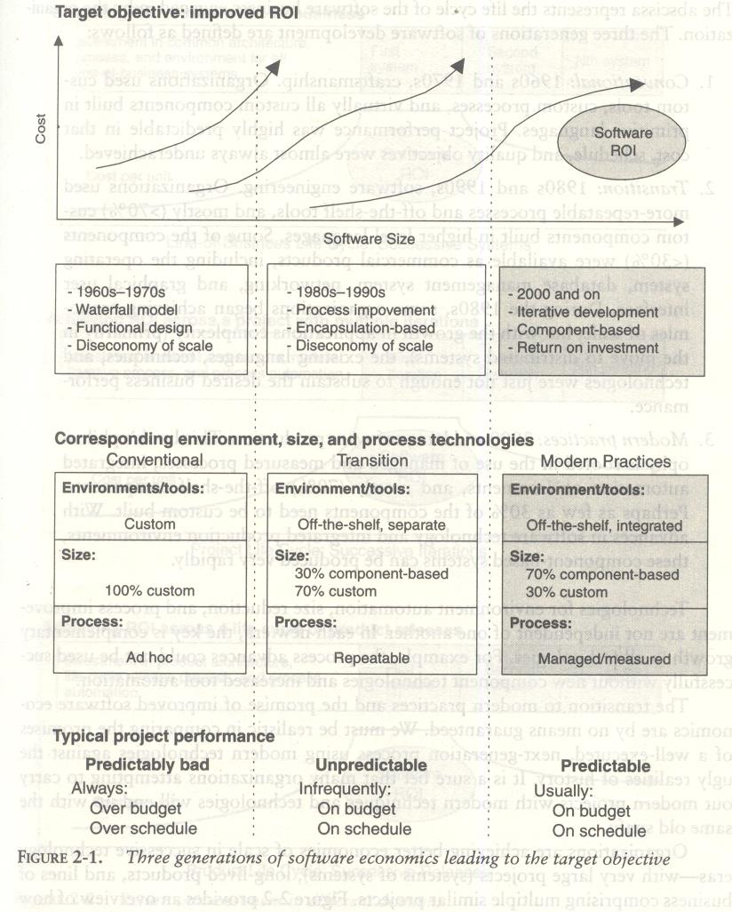

Slide 9
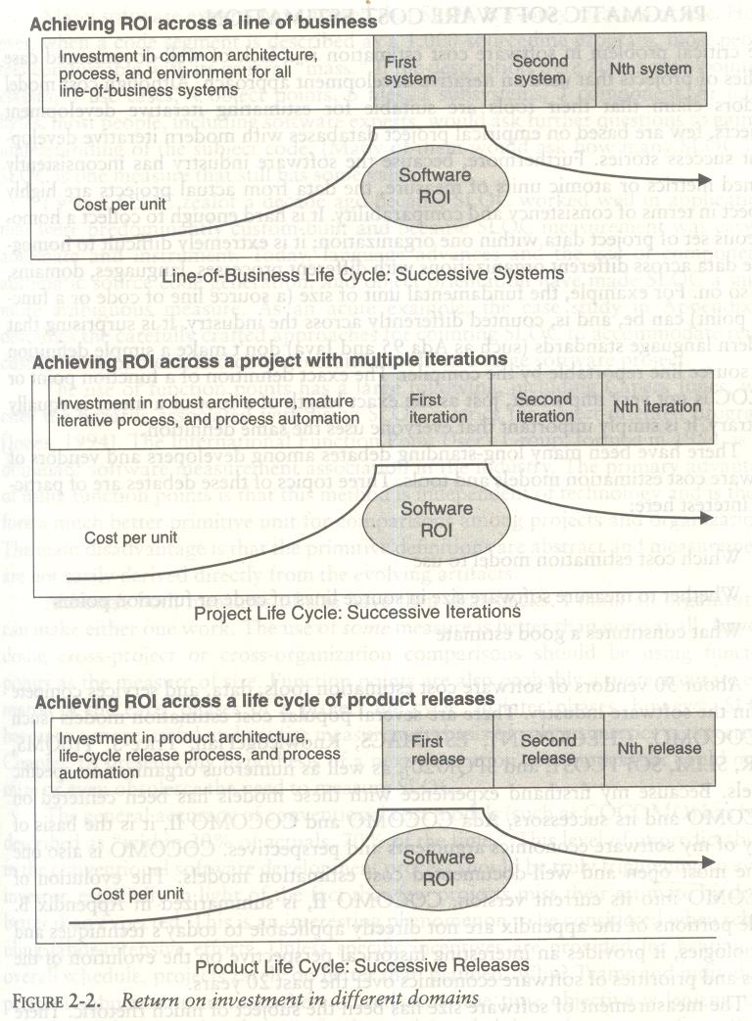

Slide 10
Pragmatic Software Cost Estimation
One critical problem in software cost estimation is a lack of well-documented case studies of projects that used an iterative development approach.
Software industry has inconsistently defined metrics or atomic units of measure, the data from actual projects are highly suspect in terms of consistency and comparability.
It is hard enough to collect a homogeneous set of project data within one organization; it is extremely difficult to homogenize data across different organizations with different processes, languages, domains, and so on.

Slide 11
Pragmatic Software Cost Estimation
There have been many debates among developers and vendors of software cost estimation models and tools.
Three topics of these debates are of particular interest here:
1. Which cost estimation model to use? 2. Whether to measure software size in source lines of code or function points. 3. What constitutes a good estimate?

Slide 12
Pragmatic Software Cost Estimation
There are several popular cost estimation models (such as COCOMO, CHECKPOINT, ESTIMACS, Knowledge Plan, Price-S, ProQMS, SEER, SLIM, SOFTCOST, and SPQR/20), CO COMO is also one of the most open and well-documented cost estimation models.
The general accuracy of conventional cost models (such as COCOMO) has been described as "within 20% of actual, 70% of the time.
" Most real-world use of cost models is bottom-up (substantiating a target cost) rather than top-down (estimating the "should" cost).
The software project manager defines the target cost of the software, and then manipulates the parameters and sizing until the target cost can be justified.
The rationale for the target cost maybe to win a proposal, to solicit customer funding, to attain internal corporate funding, or to achieve some other goal.

Slide 13
Pragmatic Software Cost Estimation
The process described in Figure 2-3 is not all bad. In fact, it is absolutely necessary to analyze the cost risks and understand the sensitivities and trade-offs objectively.
It forces the software project manager to examine the risks associated with achieving the target costs and to discuss this information with other stakeholders.
A good software cost estimate has the following attributes:
It is conceived and supported by the project manager, architecture team, development team, and test team accountable for performing the work.
It is accepted by all stakeholders as ambitious but realizable.
It is based on a well-defined software cost model with a credible basis.
It is based on a database of relevant project experience that includes similar processes, similar technologies, similar environments, similar quality requirements, and similar people.
It is defined in enough detail so that its key risk areas are understood and the probability of success is objectively assessed.

Slide 14
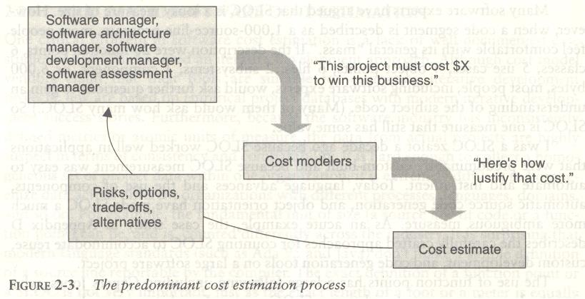
Pragmatic Software Cost Estimation

Slide 15
Improving Software Economics
Five basic parameters of the software cost model
are
Reducing the size or complexity of what needs to be developed.
Improving the development process.
Using more-skilled personnel and better teams (not necessarily the same thing).
Using better environments (tools to automate the process).
Trading off or backing off on quality thresholds

Slide 16
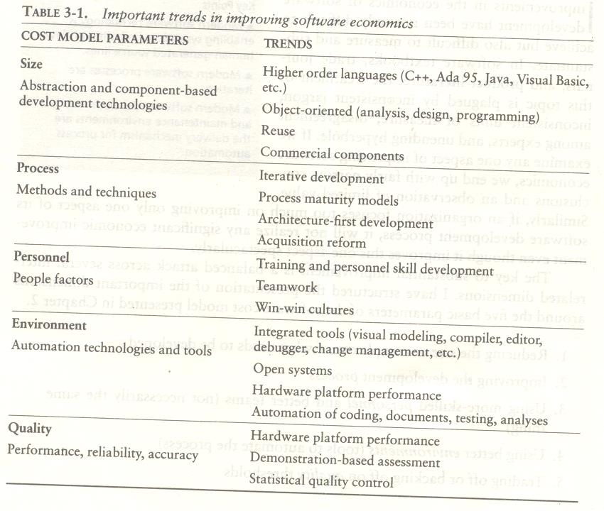

Slide 17
REDUCING SOFTWARE PRODUCT SIZE
The most significant way to improve affordability and return on investment (ROI) is usually to produce a product that achieves the design goals with the minimum amount of human-generated source material.
Component-based development is introduced as the general term for reducing the "source" language size to achieve a software solution.
Reuse, object-oriented technology, automatic code production, and higher order programming languages are all focused on achieving a given system with fewer lines of human-specified source directives (statements).

Slide 18
REDUCING SOFTWARE PRODUCT SIZE
Size reduction is the primary motivation behind improvements in higher order languages (such as C++, Ada 95,Java, Visual Basic), automatic code generators (CASE tools, visual modeling tools, GUI builders).
Reuse of commercial components (operating systems, windowing environments, database management systems, middleware, networks), and object-oriented technologies (Unified Modeling Language, visual modeling tools, architecture frameworks).
The reduction is defined in terms of human-generated source material.
In general, when size-reducing technologies are used, they reduce the number of human-generated source lines.

Slide 19
REDUCING SOFTWARE PRODUCT SIZE
LANGUAGES
Universal function points (UFPs1) are useful estimators for language-independent, early life-cycle estimates.
The basic units of function points are external user inputs, external outputs, internal logical data groups, external data interfaces, and external inquiries.
SLOC metrics are useful estimators for software after a candidate solution is formulated and an implementation language is known.
Substantial data have been documented relating SLOC to function points.

Slide 20
REDUCING SOFTWARE PRODUCT SIZE
OBJECT-ORIENTED METHODS AND VISUAL MODELING
An object-oriented model of the problem and its solution encourages a common vocabulary between the end users of a system and its developers, thus creating a shared understanding of the problem being solved.
The use of continuous integration creates opportunities to recognize risk early and make incremental corrections without destabilizing the entire development effort.
An object-oriented architecture provides a clear separation of concerns among disparate elements of a system, creating firewalls that prevent a change in one part of the system from rending the fabric of the entire architecture.

Slide 21
REDUCING SOFTWARE PRODUCT SIZE
REUSE
Reusing existing components and building reusable components have been natural software engineering activities since the earliest improvements in programming languages.
With reuse in order to minimize development costs while achieving all the other required attributes of performance, feature set, and quality.
Try to treat reuse as a mundane part of achieving a return on investment. Most truly reusable components of value are transitioned to commercial products supported by organizations with the following characteristics:
They have an economic motivation for continued support.
They take ownership of improving product quality, adding new features, and transitioning to new technologies.
They have a sufficiently broad customer base to be profitable.

Slide 22
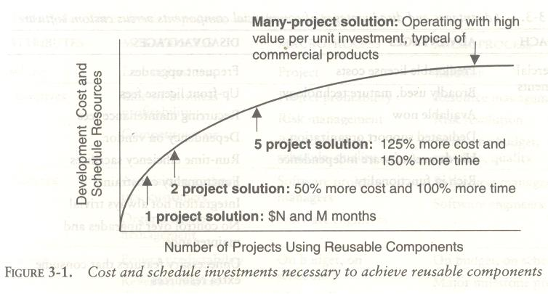

Slide 23
REDUCING SOFTWARE PRODUCT SIZE
COMMERCIAL COMPONENTS
A common approach being pursued today in many domains is to maximize integration of commercial components and off-the-shelf products.
While the use of commercial components is certainly desirable as a means of reducing custom development, it has not proven to be straightforward in practice

Slide 24
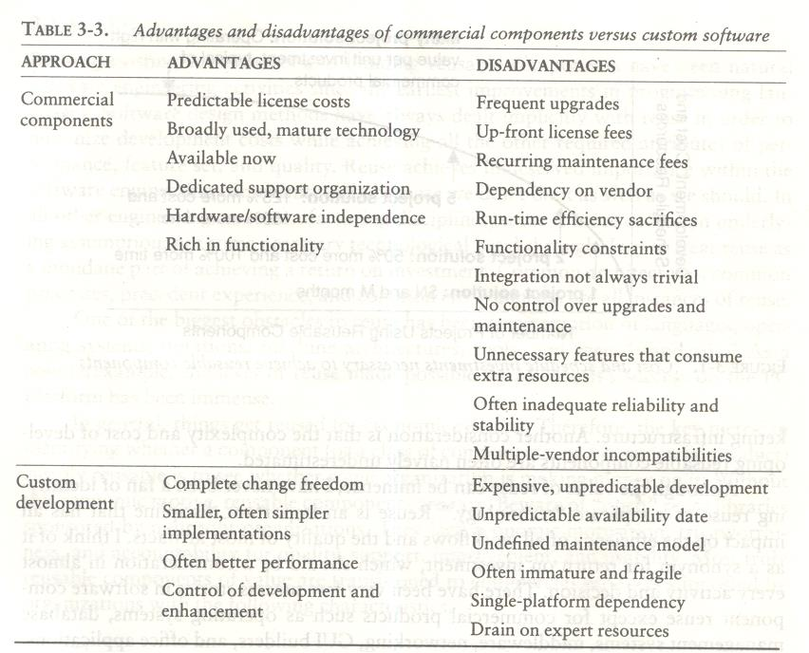

Slide 25
IMPROVING SOFTWARE PROCESSES
Process is an overloaded term. Three distinct process perspectives are.
Metaprocess: an organization's policies, procedures, and practices for pursuing a software-intensive line of business. The focus of this process is on organizational economics, long-term strategies, and software ROI.
Macroprocess: a project's policies, procedures, and practices for producing a complete software product within certain cost, schedule, and quality constraints. The focus of the macro process is on creating an adequate instance of the Meta process for a specific set of constraints.
Microprocess: a project team's policies, procedures, and practices for achieving an artifact of the software process. The focus of the micro process is on achieving an intermediate product baseline with adequate quality and adequate functionality as economically and rapidly as practical.

Slide 26
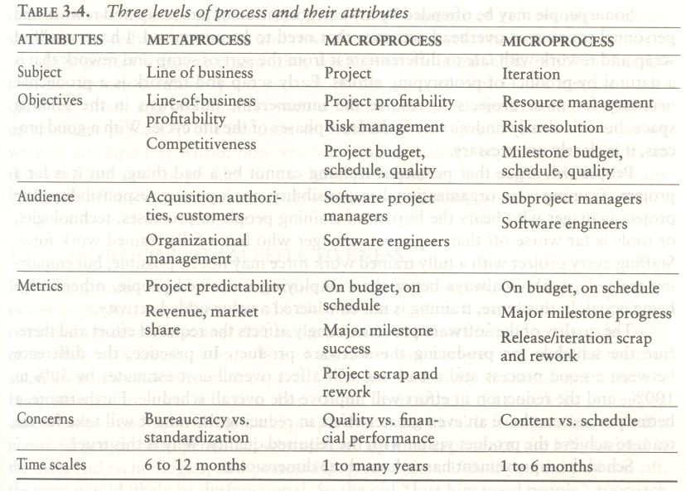
IMPROVING SOFTWARE PROCESSES

Slide 27
IMPROVING TEAM EFFECTIVENESS
Teamwork is much more important than the sum of the individuals.
With software teams, a project manager needs to configure a balance of solid talent with highly skilled people in the leverage positions.
Some maxims of team management include the following:
A well-managed project can succeed with a nominal engineering team.
A mismanaged project will almost never succeed, even with an expert team of engineers.
A well-architected system can be built by a nominal team of software builders.
A poorly architected system will flounder even with an exp

Slide 28
IMPROVING TEAM EFFECTIVENESS
Boehm five staffing principles are
The principle of top talent: Use better and fewer people
The principle of job matching: Fit the tasks to the skills and motivation of the people available.
The principle of career progression: An organization does best in the long run by helping its people to self-actualize.
The principle of team balance: Select people who will complement and harmonize with one another
The principle of phase-out: Keeping a misfit on the team doesn't benefit anyone

Slide 29
IMPROVING TEAM EFFECTIVENESS
Software project managers need many leadership qualities in order to enhance team effectiveness.
The following are some crucial attributes of successful software project managers that deserve much more attention:
Hiring skills. Few decisions are as important as hiring decisions. Placing the right person in the right job seems obvious but is surprisingly hard to achieve.
Customer-interface skill. Avoiding adversarial relationships among stakeholders is a prerequisite for success.
Decision-making skill. The jillion books written about management have failed to provide a clear definition of this attribute. We all know a good leader when we run into one, and decision-making skill seems obvious despite its intangible definition.
Team-building skill. Teamwork requires that a manager establish trust, motivate progress, exploit eccentric prima donnas, transition average people into top performers, eliminate misfits, and consolidate diverse opinions into a team direction.
Selling skill. Successful project managers must sell all stakeholders (including themselves) on decisions and priorities, sell candidates on job positions, sell changes to the status quo in the face of resistance, and sell achievements against objectives. In practice, selling requires continuous negotiation, compromise, and empathy

Slide 30
IMPROVING AUTOMATION THROUGH SOFTWARE ENVIRONMENTS
The tools and environment used in the software process generally have a linear effect on the productivity of the process.
Planning tools, requirements management tools, visual modeling tools, compilers, editors, debuggers, quality assurance analysis tools, test tools, and user interfaces provide crucial automation support for evolving the software engineering artifacts.
Above all, configuration management environments provide the foundation for executing and instrument the process.
At first order, the isolated impact of tools and automation generally allows improvements of 20% to 40% in effort. However, tools and environments must be viewed as the primary delivery vehicle for process automation and improvement, so their impact can be much higher.

Slide 31
IMPROVING AUTOMATION THROUGH SOFTWARE ENVIRONMENTS
The tools and environment used in the software process generally have a linear effect on the productivity of the process.
Planning tools, requirements management tools, visual modeling tools, compilers, editors, debuggers, quality assurance analysis tools, test tools, and user interfaces provide crucial automation support for evolving the software engineering artifacts.
Above all, configuration management environments provide the foundation for executing and instrument the process.
At first order, the isolated impact of tools and automation generally allows improvements of 20% to 40% in effort. However, tools and environments must be viewed as the primary delivery vehicle for process automation and improvement, so their impact can be much higher.

Slide 32
IMPROVING AUTOMATION THROUGH SOFTWARE ENVIRONMENTS
Round-trip engineering describes the key capability of environments that support iterative development.
As we have moved into maintaining different information repositories for the engineering artifacts, we need automation support to ensure efficient and error-free transition of data from one artifact to another.
Forward engineering is the automation of one engineering artifact from another, more abstract representation. For example, compilers and linkers have provided automated transition of source code into executable code.
Reverse engineering is the generation or modification of a more abstract representation from an existing artifact (for example, creating a visual design model from a source code representation).
Economic improvements associated with tools and environments. It is common for tool vendors to make relatively accurate individual assessments of life-cycle activities to support claims about the potential economic impact of their tools.
For example, it is easy to find statements such as the following from companies in a particular tool.

Slide 33
IMPROVING AUTOMATION THROUGH SOFTWARE ENVIRONMENTS
Requirements analysis and evolution activities consume 40% of life-cycle costs.
Software design activities have an impact on more than 50% of the resources.
Coding and unit testing activities consume about 50% of software development effort and schedule.
Test activities can consume as much as 50% of a project's resources.
Configuration control and change management are critical activities that can consume as much as 25% of resources on a large-scale project.
Documentation activities can consume more than 30% of project engineering resources.
Project management, business administration, and progress assessment can consume as much as 30% of project budgets.

Slide 34
ACHIEVING REQUIRED QUALITY
Key practices that improve overall software quality include the following
Focusing on driving requirements and critical use cases early in the life cycle, focusing on requirements completeness and traceability late in the life cycle, and focusing throughout the life cycle on a balance between requirements evolution, design evolution, and plan evolution
Using metrics and indicators to measure the progress and quality of an architecture as it evolves from a high-level prototype into a fully compliant product
Providing integrated life-cycle environments that support early and continuous configuration control,change management, rigorous design methods, document automation, and regression test automation
Using visual modeling and higher level languages that support architectural control, abstraction, reliable programming, reuse, and self-documentation
Early and continuous insight into performance issues through demonstration-based evaluations

Slide 35
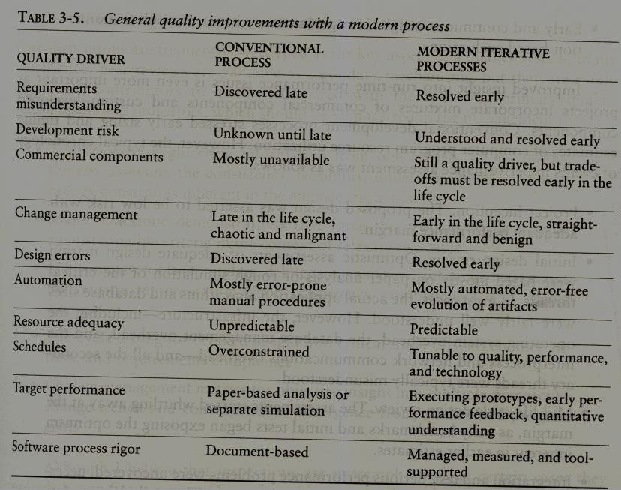
ACHIEVING REQUIRED QUALITY

Slide 36
ACHIEVING REQUIRED QUALITY
Conventional development processes stressed early sizing and timing estimates of computer program resource utilization. However, the typical chronology of events in performance assessment was as follows,
Project inception. The proposed design was asserted to be low risk with adequate performance margin.
Initial design review. Optimistic assessments of adequate design margin were based mostly on paper analysis or rough simulation of the critical threads. In most cases, the actual application algorithms and database sizes were fairly well understood.
Mid-life-cycle design review. The assessments started whittling away at the margin, as early benchmarks and initial tests began exposing the optimism inherent in earlier estimates.
Integration and test. Serious performance problems were uncovered, necessitating fundamental changes in the architecture. The underlying infrastructure was usually the scapegoat, but the real culprit was immature use of the infrastructure, immature architectural solutions, or poorly understood early design trade-offs.

Slide 37
PEER INSPECTIONS: A PRAGMATIC VIEW
Peer inspections are frequently over hyped as the key aspect of a quality system. In my experience, peer reviews are valuable as secondary mechanisms, but they are rarely significant contributors to quality compared with the following primary quality mechanisms and indicators, which should be emphasized in the management process:
Transitioning engineering information from one artifact set to another, thereby assessing the consistency, feasibility, understandability, and technology constraints inherent in the engineering artifacts
Major milestone demonstrations that force the artifacts to be assessed against tangible criteria in the of relevant use cases
Environment tools (compilers, debuggers, analyzers, automated test suites) that ensure representation rigor, consistency, completeness, and change control
Life-cycle testing for detailed insight into critical trade-offs, acceptance criteria, and requirements compliance
Change management metrics for objective insight into multiple-perspective change trends and convergence or divergence from quality and progress goals.
Inspections are also a good vehicle for holding authors accountable for quality products. All authors of software and documentation should have their products scrutinized as a natural by-product of the process. Therefore, the coverage of inspections should be across all authors rather than across all components.

